Slide 1
Cellular Automata

Slide 2
What is a Cellular Automata ?
Concept introduced by Von Neumann, Ulam and Burk in late 1940-ies and 1950-ies; (Self-reproducible mechanical automata)
Conway’s ‘Game of Life’ (Gardner, 1970)
Mathematical object defined as:
n-dimensional homogeneous and infinite cellular space, consisting of cells of equal size (2-D CA = torus, not a plane);
Cells in one of a discrete number of states;
Cells change state as the result of a transition rule;
Transition rule is defined in terms of the states of cells that are part of a neighbourhood;
Time progresses in discrete steps. All cells change state simultaneously.

Slide 3
What is a Cellular Automaton?
A one-dimensional cellular automaton (CA) consists of two things: a row of "cells" and a set of "rules".
Each of the cells can be in one of several "states". The number of possible states depends on the automaton. Think of the states as colors. In a two-state automaton, each of the cells can be either black or white.
Over time, the cells can change from state to state. The cellular automaton's rules determine how the states change.
It works like this: When the time comes for the cells to change state, each cell looks around and gathers information on its neighbors' states. (Exactly which cells are considered "neighbors" is also something that depends on the particular CA.)
Based on its own state, its neighbors' states, and the rules of the CA, the cell decides what its new state should be. All the cells change state at the same time.

Slide 4
3 Black = White
2 Black = Black
1 Black = Black
3 White = White
Now make your own CA

Slide 5
2-Dimensional Automata
2-dimensional cellular automaton consists of an infinite (or finite) grid of cells, each in one of a finite number of states. Time is discrete and the state of a cell at time t is a function of the states of its neighbors at time t-1.

Slide 6
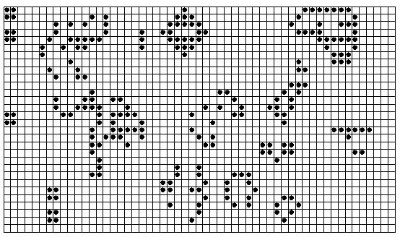
Conway’s Game of Life
The universe of the Game of Life is an infinite two-dimensional grid of cells, each of which is either alive or dead. Cells interact with their eight neighbors.

Slide 7
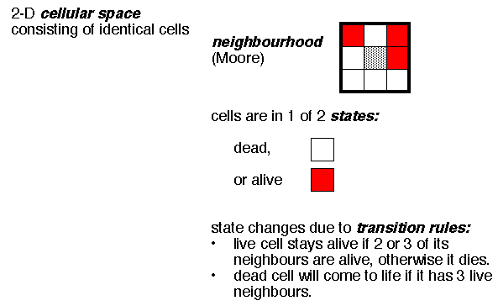
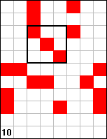
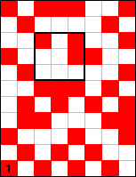
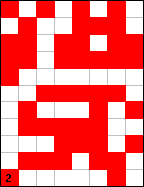
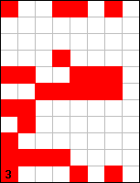
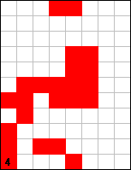
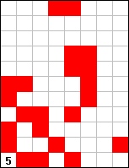
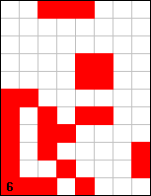
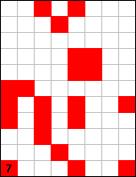
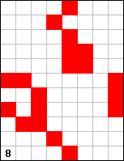
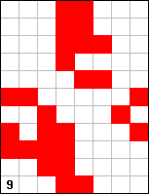
Example of a Cellular Automata: Conway’s Life (Gardner, 1970)

Slide 8
Rules for Game of Life
The universe of the Game of Life is an infinite, two-dimensional orthogonal grid of square cells, each of which is in one of two possible states, live or dead (or populated and unpopulated, respectively).
Every cell interacts with its eight neighbors, which are the cells that are horizontally, vertically, or diagonally adjacent.
At each step in time, the following transitions occur:
Any live cell with fewer than two live neighbors dies, as if by underpopulation.
Any live cell with two or three live neighbors lives on to the next generation.
Any live cell with more than three live neighbors dies, as if by overpopulation.
Any dead cell with exactly three live neighbors becomes a live cell, as if by reproduction.

Slide 9
Conway’s Game of Life
At each step in time, the following effects occur:
Any live cell with fewer than two neighbors dies, as if by loneliness.
Any live cell with more than three neighbors dies, as if by overcrowding.
Any live cell with two or three neighbors lives, unchanged, to the next generation.
Any dead cell with exactly three neighbors comes to life.
The initial pattern constitutes the first generation of the system. The second generation is created by applying the above rules simultaneously to every cell in the first generation -- births and deaths happen simultaneously. The rules continue to be applied repeatedly to create further generations.

Slide 10
Applications of Cellular Automata
Simulation of Biological Processes
Simulation of Cancer cells growth
Predator – Prey Models
Art
Simulation of Forest Fires
Simulations of Social Movement
…many more.. It’s a very active area of research.

Slide 11
This allows any string of eight 0s and 1’s to represent a distinct update rule
Example: Consider the string 0 1 1 0 1 0 1 0 it can be taken to represent the update rule
1 1 1 1 1 0 1 0 1 1 0 0 0 1 1 0 1 0 0 0 1 0 0 0
0
1
1
0
1
0
1
0
Or equivalently
Now think of 01101010 as the binary expansion of the number
0 2⁷+ 1 2⁶+ 1 2⁵+ 0 2⁴+1 2³+ 0 2²+ 1 2¹+ 0 2⁰ = 64+32+8+2=106.
So the update rule is rule # 106

Slide 12
Rule #45=32+8+4+1
= 0 2⁷+ 0 2⁶+ 1 2⁵+ 0 2⁴+1 2³+ 1 2²+ 0 2¹+ 1 2⁰ =0 0 1 0 1 1 0 1
Rule #30=16+8+4+2
= 0 2⁷+ 0 2⁶+ 0 2⁵+ 1 2⁴+1 2³+ 1 2²+ 1 2¹+ 0 2⁰ =0 0 0 1 1 1 1 0
This naming convention of the 256 distinct update rules is due to Stephen Wolfram. He is one of the pioneers of Cellular Automata and author of the book a New Kind of Science, which argues that discoveries about cellular automata are not isolated facts but have significance for all disciplines of science.
Let’s visualize some of these rules using a Mathematica notebook

Slide 13
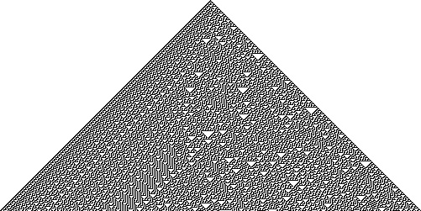
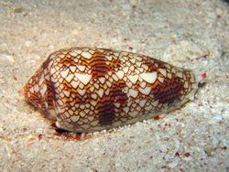
Automata generated using Rule 30
appear in nature, on some shells.
current pattern | 111 | 110 | 101 | 100 | 011 | 010 | 001 | 000
new state for center cell | 0 | 0 | 0 | 1 | 1 | 1 | 1 | 0

Slide 14
Patterns in Rule 184
Patterns in Rule 184 typically quickly stabilize, either to a pattern in which the cell states move in lockstep one position leftwards at each step, or to a pattern that moves one position rightwards at each step.
Specifically, if the initial density of cells with state 1 is less than 50%, the pattern stabilizes into clusters of cells in state 1, spaced two units apart, with the clusters separated by blocks of cells in state 0. Patterns of this type move rightwards.
If, on the other hand, the initial density is greater than 50%, the pattern stabilizes into clusters of cells in state 0, spaced two units apart, with the clusters separated by blocks of cells in state 1, and patterns of this type move leftwards.
If the density is exactly 50%, the initial pattern stabilizes (more slowly) to a pattern that can equivalently be viewed as moving either leftwards or rightwards at each step: an alternating sequence of 0s and 1s.

Slide 15

Traffic flow
Rule 184 interpreted as a simulation of traffic flow. Each 1 cell corresponds to a vehicle, and each vehicle moves forwards only if it has open space in front of it.
Although very primitive, the Rule 184 model of traffic flow already predicts some of the familiar emergent features of real traffic: clusters of freely moving cars separated by stretches of open road when traffic is light, and waves of stop-and-go traffic when it is heavy.

Slide 16
Langton’s Loops: A self-replicating Cellular Automata
https://www.youtube.com/watch?v=7bP76zt3uGw
https://www.youtube.com/watch?v=jvSp6VHt_P10c

